Slide 1
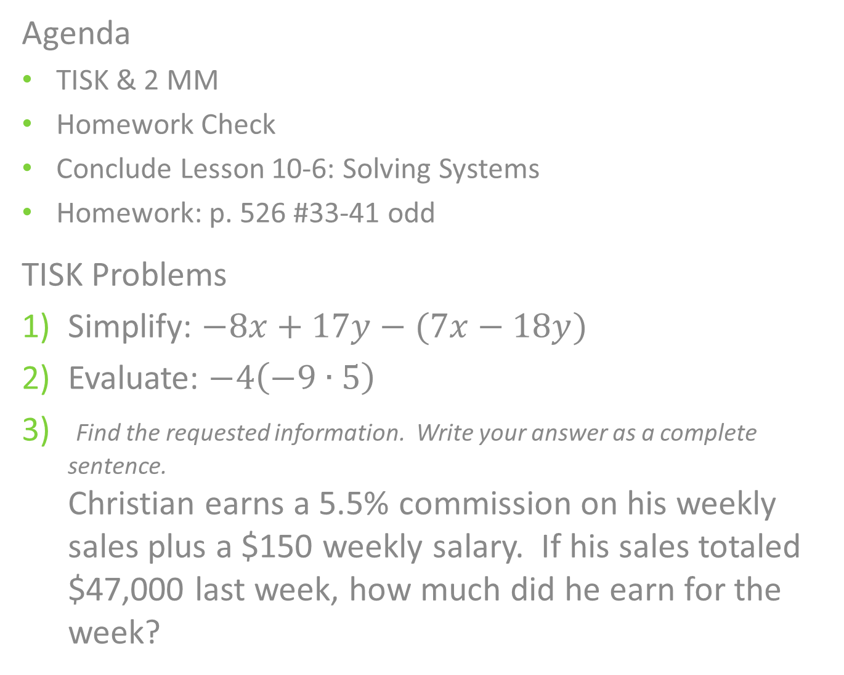
Wednesday, November 28, 2012
Agenda
TISK & 2 MM
Homework Check
Conclude Lesson 10-6: Solving Systems
Homework: p. 526 #33-41 odd
TISK Problems
Simplify: $−8x+17y−(7x−18y)$
Evaluate: $−4\left(−9∙5\right)$
Find the requested information. Write your answer as a complete sentence.
Christian earns a 5.5% commission on his weekly sales plus a $150 weekly salary. If his sales totaled $47,000 last week, how much did he earn for the week?
Notes:
Mental Math
1.) Start with the product of 12 and 3. Divide by 4. Subtract 28. Add 1. Find half. Write the absolute value of your answer. (9)
2.) Start with the product of 15 and 3. Divide by 5. Subtract 37. Find half. Add 20. Write the absolute value of your answer. (6)

Slide 2
Homework Check
(2, -4)
(0, 2)
(-1, -3)
(4, 0)
(4, 3)

Slide 3
§10.6 Solving Systems
Another way to solve a system of equations is by using the substitution method.
In this method, you follow a few basic steps:
  Solve all equations for y.
  Set the x parts of the equations equal.
  Solve for x.
  Plug the x-value back in to find y.

Slide 4



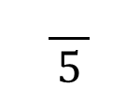




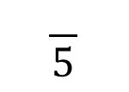
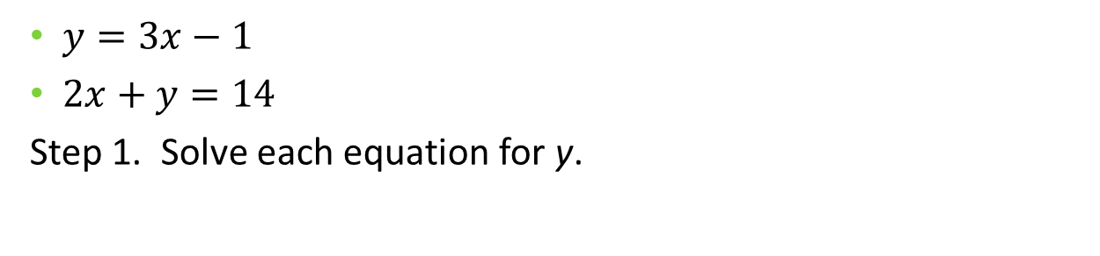













Example. Solve the system by substitution.
$y=3x−1$
$2x+y=14$
Step 1. Solve each equation for y.
Our goal is to find out when these y-values are the same. Therefore, set them to be equal.
$$y=3x−1$$
$$2x+y=14$$
$$−2x$$
$$−2x$$
$$y=−2x+14$$
Step 2. Set the x parts equal to each other.
$$−2x+14$$
$$y=3x−1$$
Step 4. Plug in x
to solve for y.
$$+2x$$
$$+2x$$
Step 3. Solve for x.
$$14=5x−1$$
$$+1$$
$$+1$$
$$y=3x−1$$
$$15=5x$$
$$y=3(3)−1$$
$$\frac{ }{5}$$
$$\frac{ }{5}$$
$$y=9−1$$
$$3=x$$
$$y=8$$
$$(3, 8)$$

Slide 5

Example. Solve by substitution.
$2x−3y=15$
$4x+y=9$

Slide 6

You Try It.
Solve by substitution.
$y=2x+5$
$3y+9=6x−9$

